Slide 1

Linux Installation
Hamed Janzadeh
janzadeh@ce.aut.ac.ir

Slide 2
Contents
Linux Installation
Linux Post-Installation

Slide 3
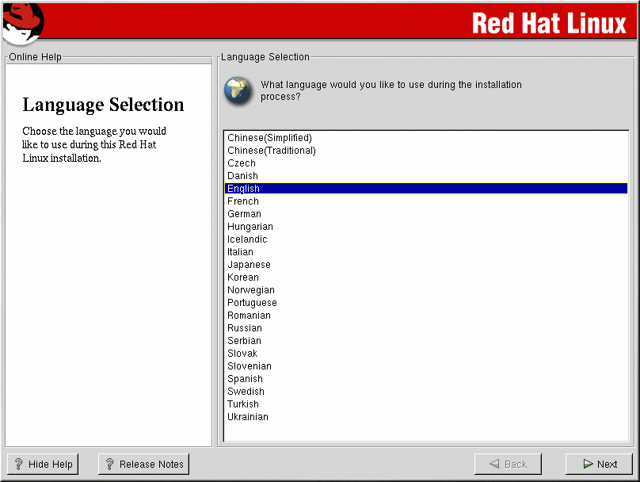
Language Selection

Slide 4
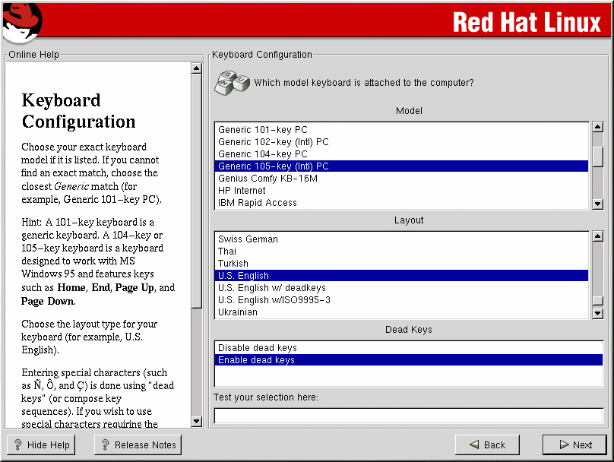
Keyboard Configuration

Slide 5
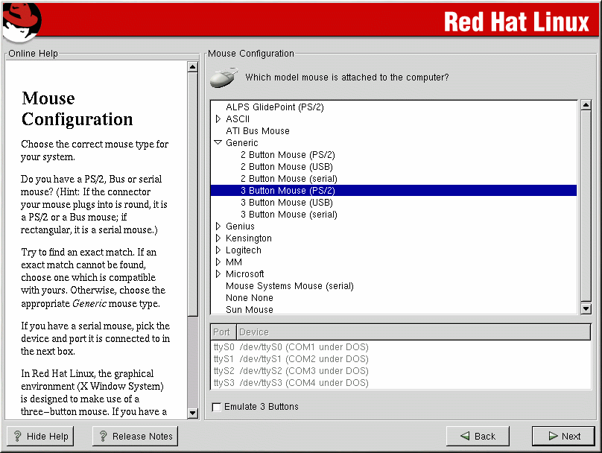
Mouse Configuration

Slide 6
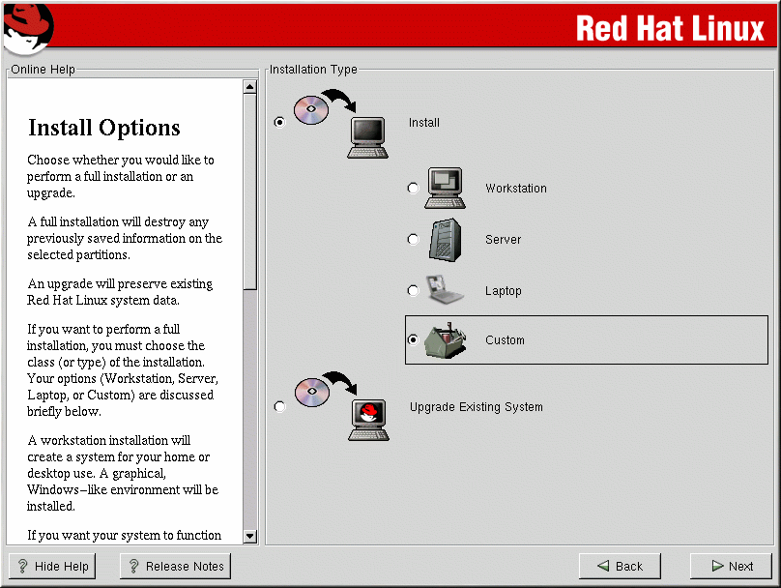
Installation Type

Slide 7
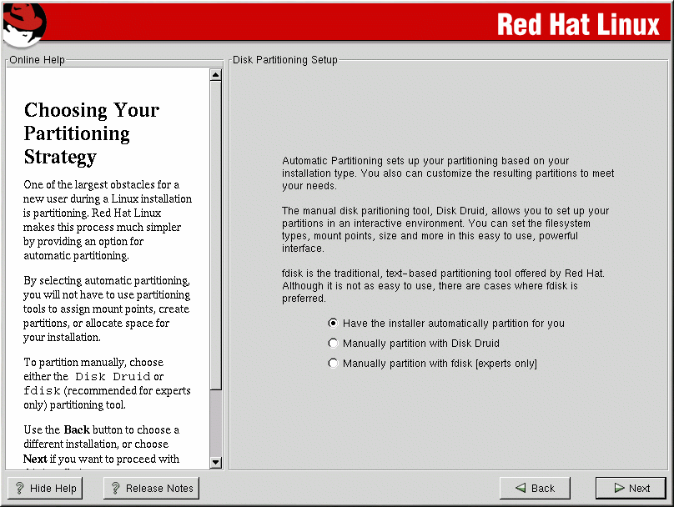
Partitioning Strategy

Slide 8
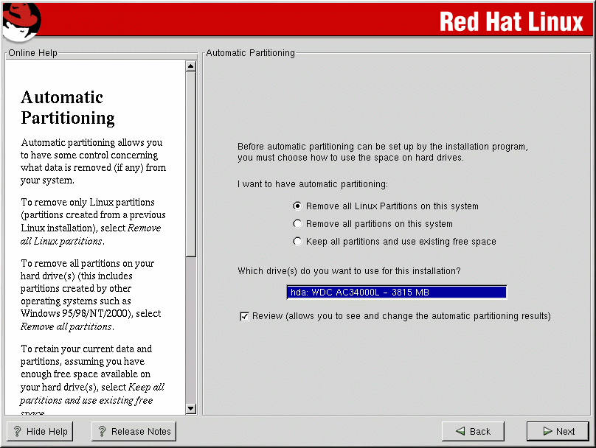
Automatic Partitioning

Slide 9
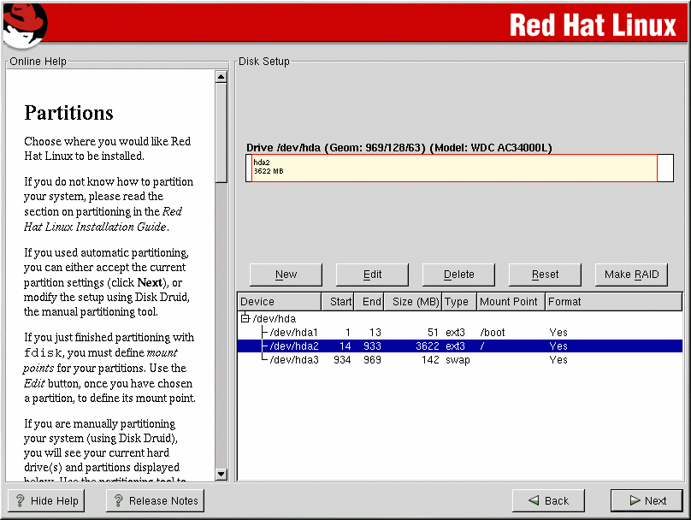
Disk Druid

Slide 10
fdisk
It is manually
m : print help
n : create new partition
d : delete new partition
t : changes a partition system id
l : list known partition types
p : print partition table
q : quit without saving changes
w : write table to disk and exit

Slide 11
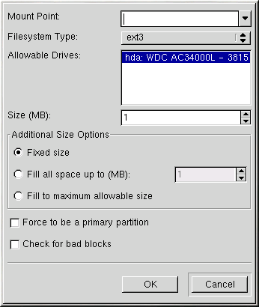
Mounting Partitions

Slide 12
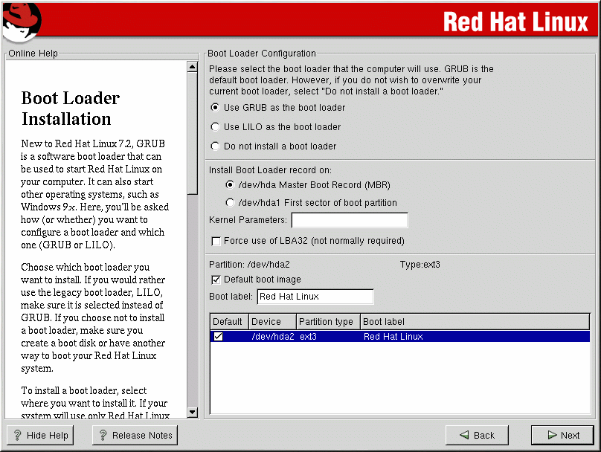
Boot Loader Installation

Slide 13
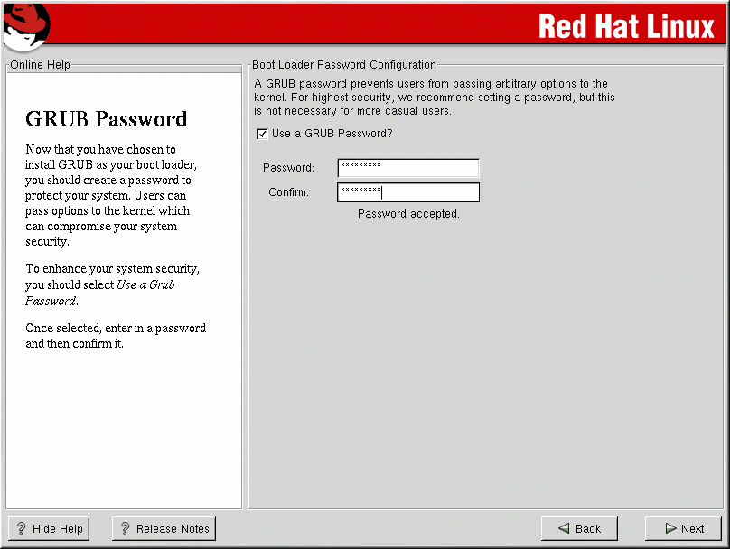
GRUB Password

Slide 14
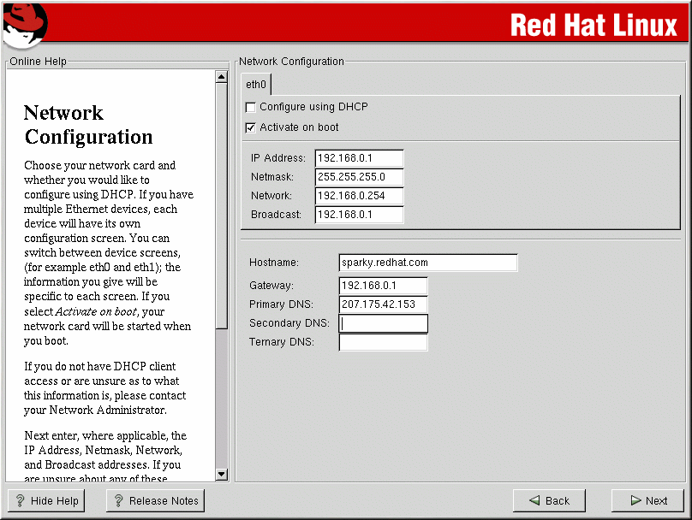
Network Configuration

Slide 15
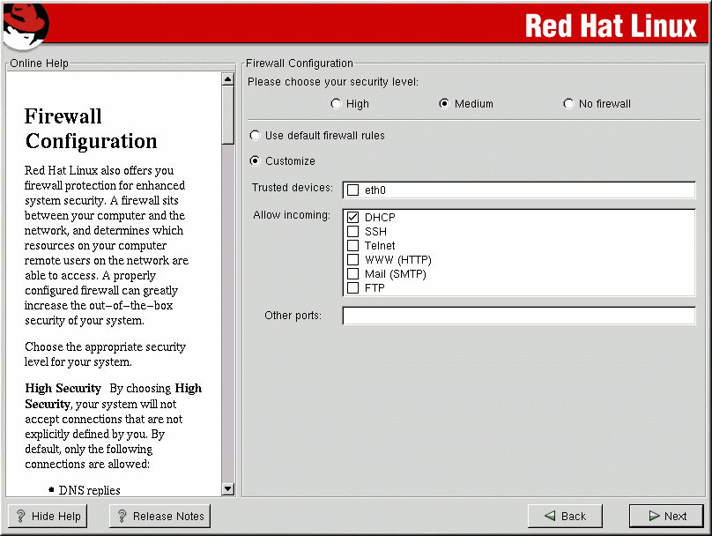
Firewall Configuration

Slide 16
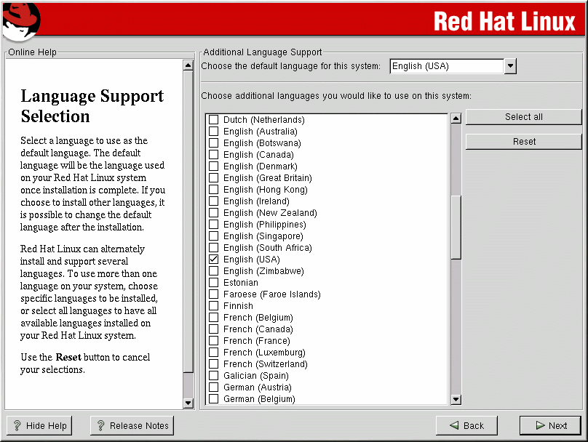
Language Support

Slide 17
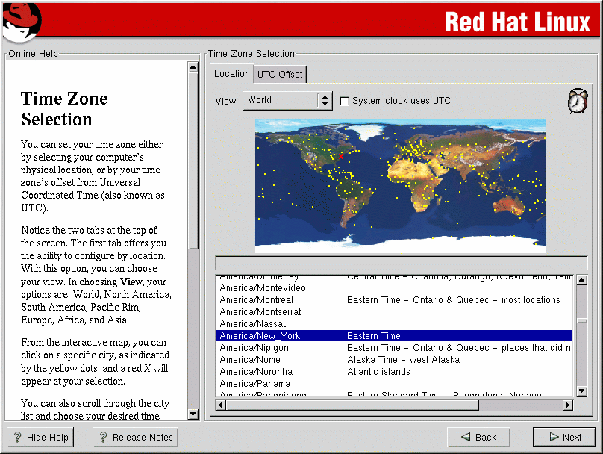
Time Zone Configuration

Slide 18
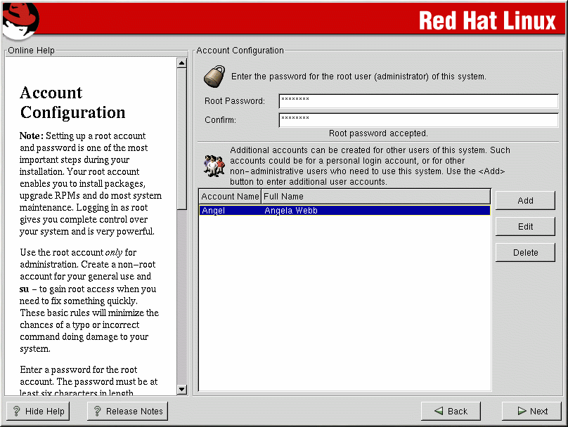
Account Configuration

Slide 19
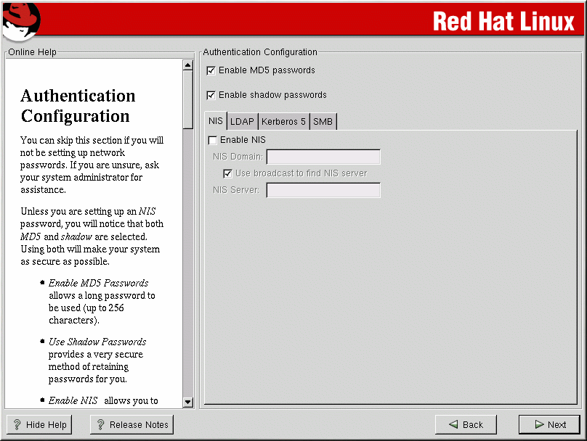
Authentication Configuration

Slide 20
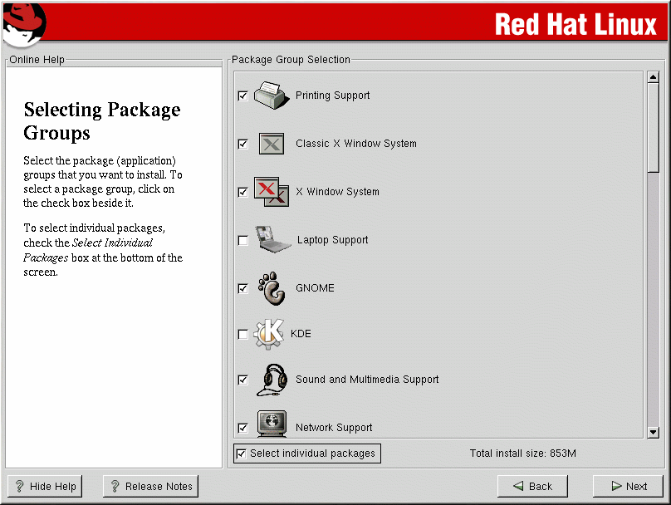
Select Package Group

Slide 21
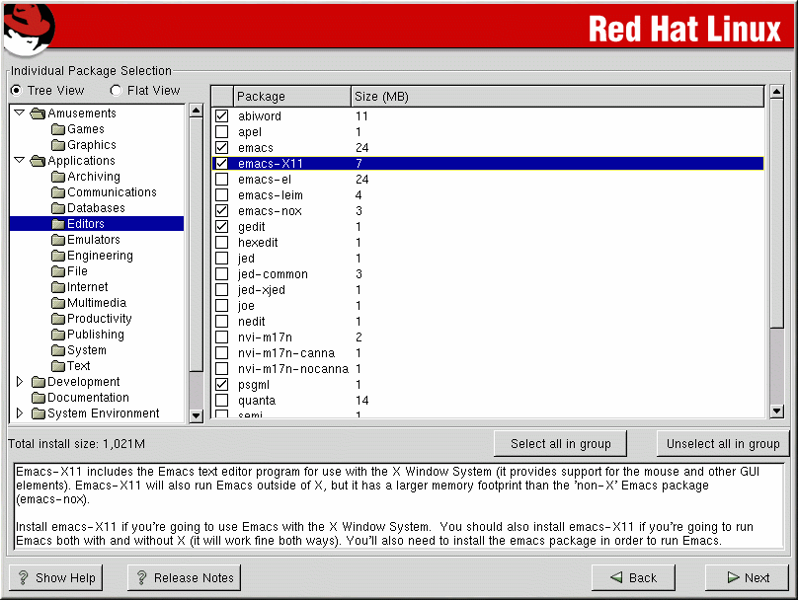
Individual Packages

Slide 22
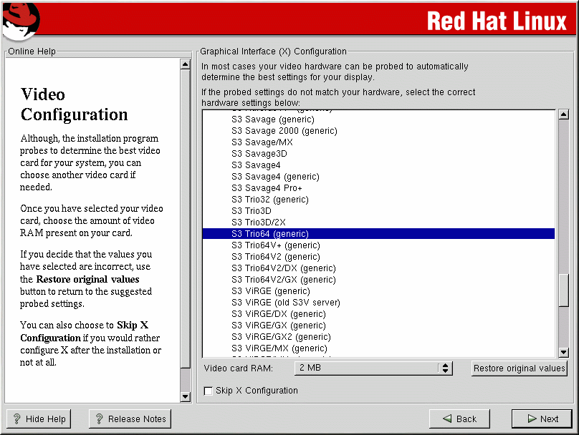
X Configuration

Slide 23
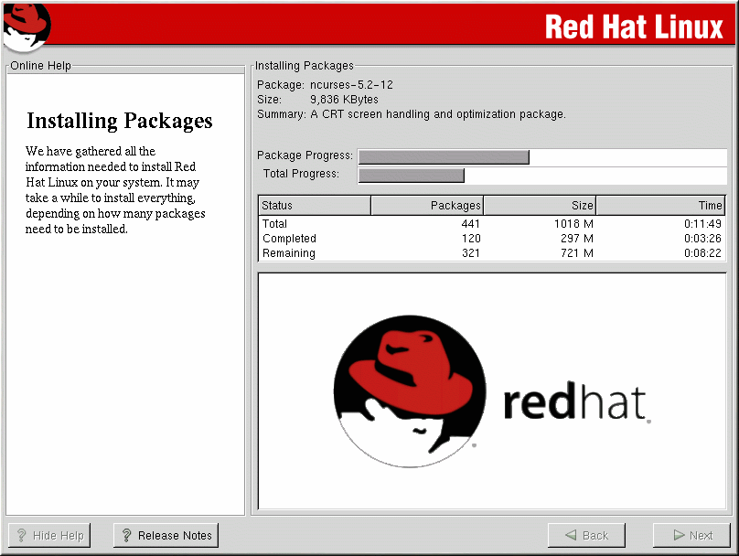
Installing Packages

Slide 24
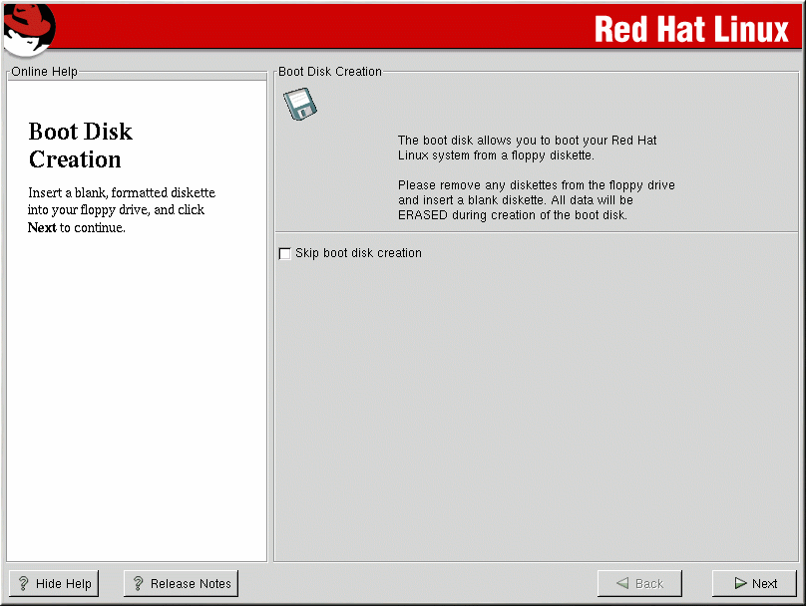
Boot Disk Creation

Slide 25
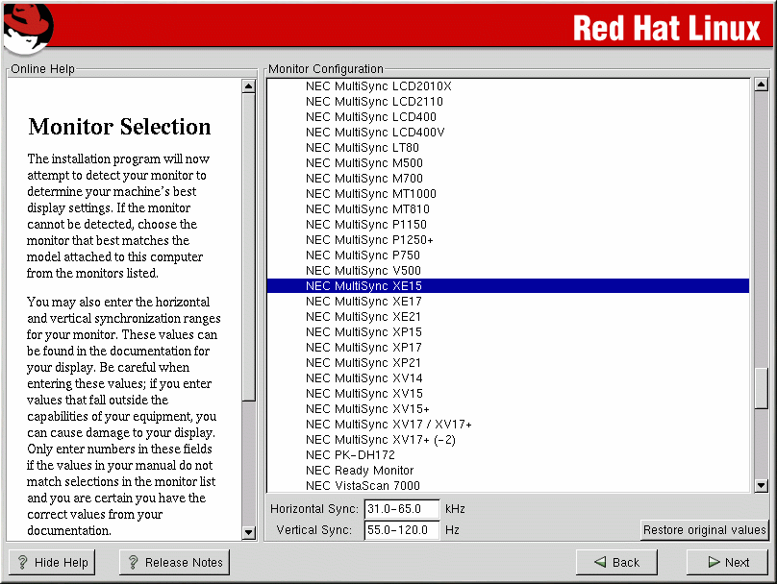
Monitor Selection

Slide 26
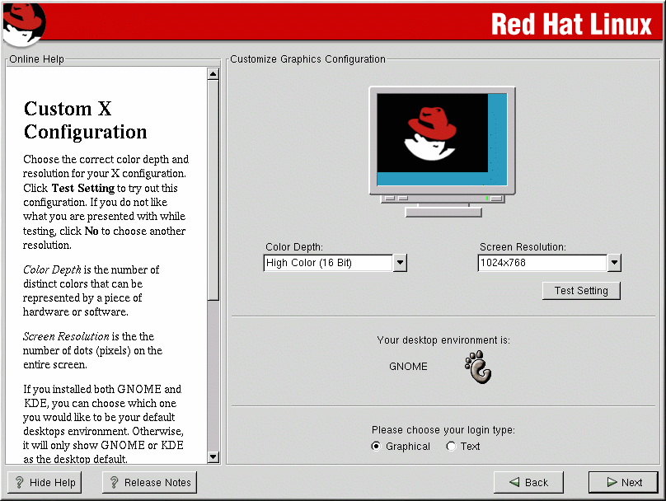
Custom X Configuration

Slide 27
Contents
Linux Installation
Linux Post-Installation

Slide 28
Keyboard Configuration
kbdconfig
/etc/sysconfig/keyboard

Slide 29
Mouse Configuration
mouseconfig
/etc/sysconfig/mouse

Slide 30
X Configuration
xf86config
Xconfigurator
/usr/X11R6/lib/X11/XF86Config

Slide 31
Sound Configuration
sndconfig

Slide 32
Network Configuration
netconfig

Slide 33
Modem Configuration
modemconf
ln –s /dev/ttyS0 /dev/modem

Slide 34
Printer Configuration
printtool

Slide 35
Useful Command
setup

Slide 36
Question?

